Slide 1
DIGITAL ELECTRONICS (EC-262) PROJECT
SUBMITTED BY : --- SUBMITTED TO :---
VARUN KUMAR (2K19-IT-140) Dr. M S Choudhry
YASHIT KUMAR (2K19-IT-149)

Slide 2
4-BIT MULTIPLIER

Slide 3
OBJECTIVE
A Binary Multiplier is a digital combinational circuit used for multiplying two binary numbers .
We have designed a array multiplier which gives product of two 4 bit numbers.

Slide 4
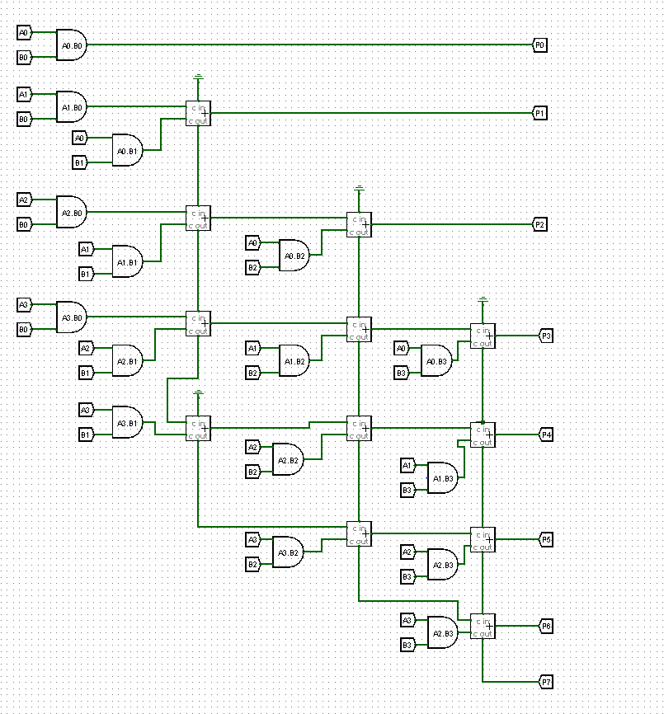

Slide 5
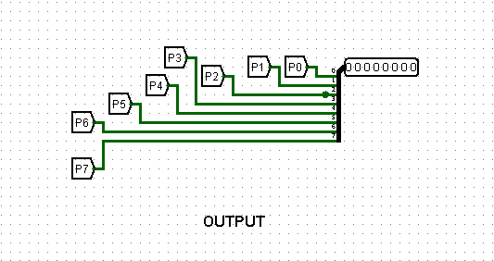

Slide 6
COMPONENTS USED
Logic Gates
HexaDecimal to Binary Encoder
Adders
Binary to BCD convertor
BCD to 7 Segment Decoder
7 Segment Display

Slide 7
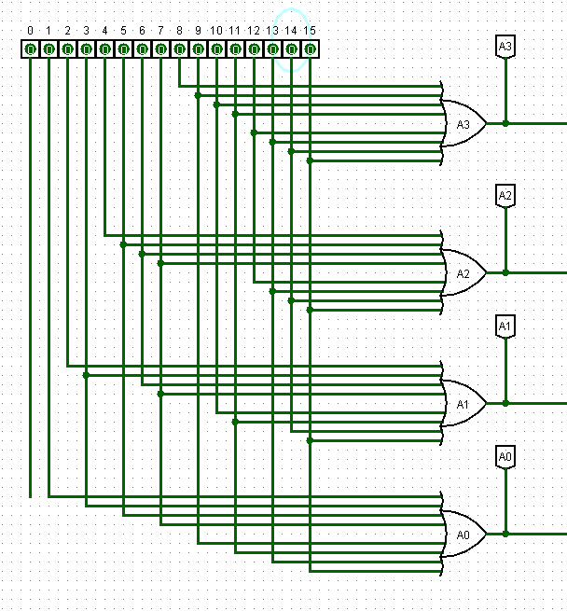
HEXADECIMAL TO BINARY ENCODER

Slide 8
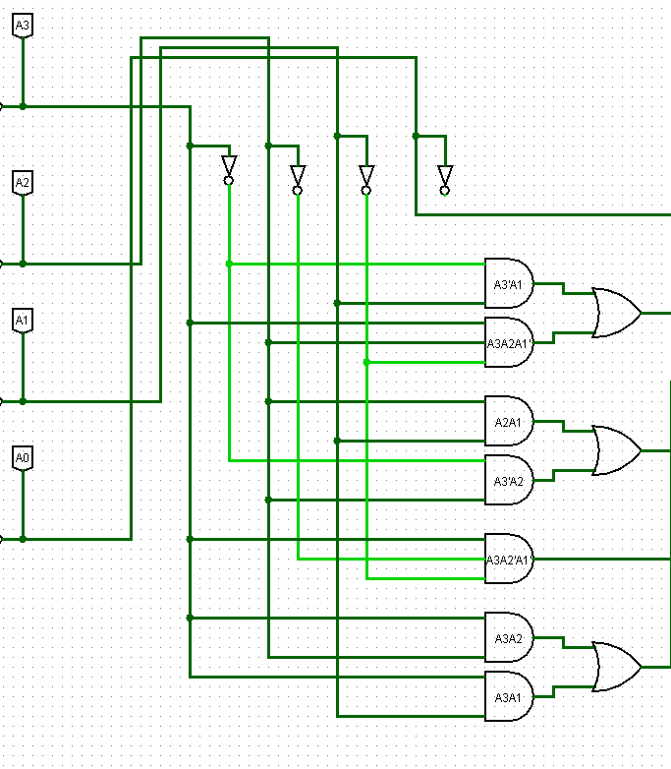
BINARY TO BCD CONVERTOR

Slide 9
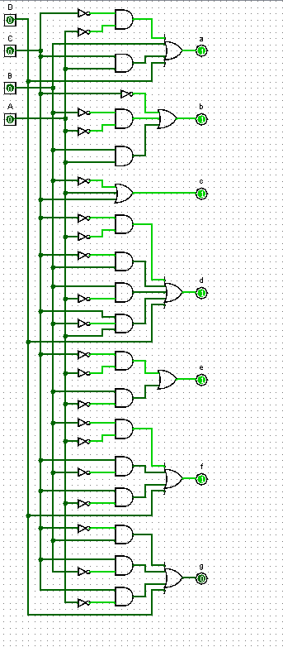
BCD TO 7 SEGMENT DECODER

Slide 10
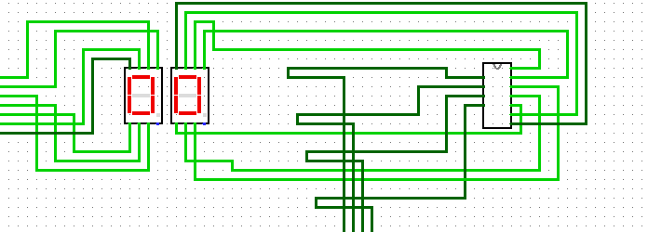
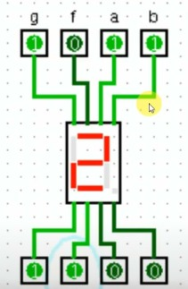
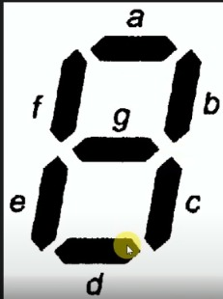
7 SEGMENT DISPLAY

Slide 11
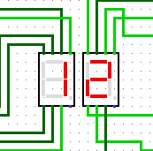
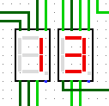
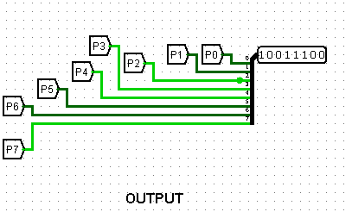
OUTCOME

